Slide 1
CS2040C
Near ppt-less class continues
Zoom etiquette:
Login using NUS account
No waiting room, so please do not share the meeting link publicly to keep the participants mostly from this class only
Mute yourself
Use display name = your name as in matric card,
Use profile picture = your picture as in matric card (or any non-blank profile picture),
You are allowed to turn off your video if you prefer it that way (there is an optional we-fie session at the end)
Raise hand when you want to ask, I will occasionally see the participants window
Do NOT annotate on screen UNLESS the slides are designed for e-annotation and I instructed you to do so
Use private chat if you want to talk to others in this class during this class (very distracting to me otherwise), only use chat to me/public if you are invited to talk and want to give something that is better done via text, e.g., an URL

Slide 2
Admins/Wed
CP4 pre-order fulfillment → done
About ~50 students (various modules) who pre-ordered have collected theirs
CP4 is going to be in NUS Co-op within this week
There is a difference in pricing due to 7% GST and NUS Co-op fees
A few are (already) known to be struggling (with basic C++), so utilize our various consultation slots (starting soon), see https://www.comp.nus.edu.sg/~stevenha/cs2040c.html#registration
I think almost all have lab (+tutorial group) by now

Slide 3
Basic C++ Review, continued
We use some of the easier Trial PS0 problems as another warm up:
Those who have solved it, please see if I have new C++ tips for you
mirror (2D character array manipulation)
gerrymandering (simulation, reading comprehension, two 1D arrays)
pervasiveheartmonitor (string processing/tokenization; find average)
Seven other “harder” ones are left for students to try by this Saturday, 22 August 2020, 07.59am
Then we move on to the first “real” CS2040C topics: Sorting
Notes:
Kattis autori, introducing istringstream (C++) or StringTokenizer or String.split… other approach exist like just using C string (array of character) tokenizer or even just a simple loop, one liner python
Kattis filip, highlighting a function for readability/code maintenance (more in future software engineering courses): ReverseDigits, one liner python

Slide 4
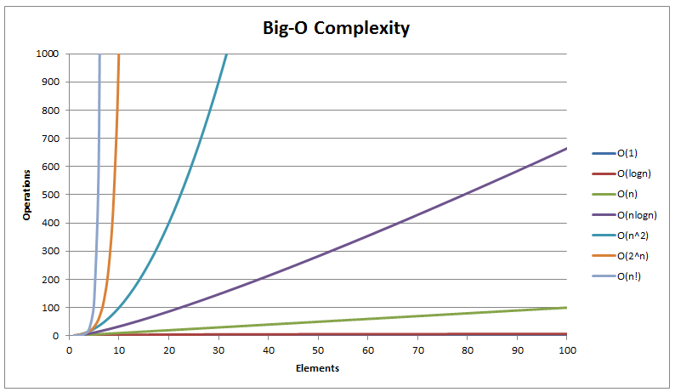
Typical Picture
Notes:
Screenshot from: https://www.hackerearth.com/practice/notes/sorting-and-searching-algorithms-time-complexities-cheat-sheet/ but I can always generate such thing by myself

Slide 5
Asymptotic Algorithm Analysis
On why I said the ranges in Trial PS0 easier tasks are “small”?
O(TRC) for mirror, but T ≤ 100, R ≤ 20, C ≤ 20, O(40000), ~ O(1) in the worst case
O(P+D) for gerrymandering, P ≤ 10000, D ≤ 1000, O(11000), ~O(1) too
O(LT) for pervasiveheartmonitor, L (number of lines in input is “unknown”, maybe “big”) but T (number of tokens in a line is at most 25 and each token is at most 10 characters), so O(L)
Simple live demonstration of O(1), O(n), O(n log n), O(n²)
We will complicate this with log n, O(n³), n!, 2^{n} in the future
For more self experiment, see speedtest.java/cpp
PS: We will frequently do such big O asymptotic algorithm analysis throughout our CS2040/C class, so this topic is not a one-off lecture but will be repeated many times…
Hopefully most of you master it by the time this course is over
Notes:
Not discussed: Last AYs Week -01 stuffs: hello is O(1), judgingmoose is O(1), timeloop is O(N), mia is O(T) where T is the number of test cases, O(1) per test case, treasurehunt O(RC) at most
Kattis statistics, yes O(n) is the best that we can do, denoted as Ω(n), i.e. the best that you can do is to read all n integer once to determine the true min and true max (and range)
In CS2040/C, we focus on worst case analysis (big O) and not the best case (Omega Ω) or average case (Theta Θ)
PS: We can be more precise and say it is O(T*n) but T is at most 10 so you are also correct to say it is O(10*n) = O(n);
If the variable value is small, we can somehow treat it as “constant”…, but use this with caution…
For review of this speed demo, see speedtest.cpp/java
Rule of thumb: 2019 machine can do about 100 million, that is 10^8 operations, in 1s

Slide 6
End of Lecture 02a

Slide 7
Admins/Thu
CP4 Book 1 (and 2) at NUS co-op ☺ - I have “no more” stock :O
Zone C (many of us): Just go to the newly renovated Central Library co-op
Must show uNivUS → health profile → pass, only for Zone C people
For Zone A+B (Zone D+E :O need to go to Popular):
Order online first: https://nuscoop.nus.edu.sg/catalogsearch/textbook/result/?q=Competitive+Programming
Zone A (most CEG year 1-2/Eng/Yale-NUS students), collect at UTown Bookhaven
Zone B (some SCI students), collect at LT27 co-op
Price (after GST and various bargaining):
Book 1: 24.6 SGD nett (Popular will be 32.0 SGD nett)
Book 2: 29.6 SGD nett (Popular will be 34.15 SGD nett)
Shares: SGP Gov (7% GST), NUS co-op (X₁%)/Popular (X₂% including of local shipping cost to various Popular branches island-wide), my publisher (Y%), my publisher’s printing subsidiary (Z%)
I will only get a fraction of these :O
By now, all but one of 116 students have a lab(+tutorial) group ☺

Slide 8
Sorting, continued
Kattis – mjehuric (skipped, already used for 2 AYs)
What else, if not “that” basic sorting algorithm
Kattis – height (only used once last AY, a bit lame to re-code)
Another classic basic sorting algorithm, I will just show my code
[skipped] Q&A of basic sorting problem in general and various O(N²) sorting algorithms as there was usually none in past few semesters…
We will discuss Merge/Quick/Rand-Quick/Radix/Counting next week
Kattis – lineup (used last AY, but I want to re-code live)
Sorting objects based on certain key(s) :O
We can ignore “the theories” covered in CS2040/C first and just use library code (if you know how to use the proper library code for this problem) :O…
Kattis – sortofsorting (deferred to next Wed)
Notes:
Kattis – mjehuric, just a review of bubble sort :O (not discussed this AY)
Kattis – height, just do insertion sort simulation
Kattis - lineup, sort asc, sort desc (or reverse the sort asc vector), compare vector/ArrayList, skipped this time, see attachment

Slide 9
For Next Week’s L3a
Self read https://visualgo.net/en/sorting?slide=9 to the end
We will switch to longer analysis mode as Merge Sort, Quick Sort, and maybe also Radix Sort are ‘not that easy to fully understand’ compared to the easier O(n²) sorting algorithms
Slides that are still found to be hard (by some of you next week) will be further refined for future CS2040/C classes
PS1 opens 8am this Saturday, 22 August 2020 and will run for 2 weeks/14 days/168*2 = 336 hours :O
https://nus.kattis.com/sessions/visqcj
A bunch of rules in the next few slides

Slide 10
PS Rules 1
Write your matric number, full name (as in LumiNUS class roster), lab(+tut) group number, lab(+tut) group TA name as first FOUR lines of comments in your code
We need to tie your submission with you, as some of you use personal email address etc when signing up with nus.kattis
No “real” penalty for any wrong submission, but of course the more wrong submissions that you make, the lower your chance to do well in actual Practical Exam later on Week 11 :O…
Rank is determined by score, then total number of unit time (elapsed time + 20m penalty per any non Accepted code)
Top 14 are publicly shown in the ranklist (for achievement purposes)
The rest are “hidden”, none of your peer knows where you are unless you reveal
Me & TAs all know this info though…

Slide 11
PS Rules 2
Public discussion of ALGORITHM is allowed (e.g. in Discord, our FB group, etc)
Sharing code totally NOT allowed
Challenge to top students: Do NOT use (sorting) libraries in your code at all :O
To minimize ‘similarities’ with code of other peers that you ‘interact with’…
Scoring for this PS1 is as score indicated by Kattis/200 points * 3%
Getting about ~150/200 points is easy, getting 200 points may be (very) challenging
TA generally will not check too much, i.e., manpower saving by using automated judging system
We give *very small* partial additional marks for non green, i.e., red submissions at the end
TA generally only see last red submission and will try to give you closure AFTER deadline
We give 0 to anyone who are reported by Kattis system to have plagiarized and can be proven without reasonable doubt that the student
Submit friend’s OR senior’s code
Submit google-able code :O, i.e., somebody’s solution in public GitHub, public repl, public ideone, etc…
Uploads/shares code to other(s), privately or publicly (i.e., the SOURCE)…
“Helps friend” and “accidentally” submit that friend’s code under YOUR own account…

Slide 12
PS Rules 3
Any other loopholes that may still exist will be closed over time
All the best in completing PS1 with your own strength
TAs will help, but not on PS opening day, we maintain radio silence on PS opening day ☺
TAs will especially help nearing PS deadline :O…

Slide 13
End of Lecture 02b
Don’t forget to complete self-reading of https://visualgo.net/en/sorting?slide=9 to the end
Attempting some PS1 (sub)tasks is also helpful for next session ☺

